Slide 1
Clinical Variability and Patient Outcome
2022 Semester1
Group 29
Zhiyuan Chen
Zhi Hern Tom
Ya Cho
Suyi Jiao
Zhuoling Chen

Slide 2
Outline
Introduction
Data preliminary
Ways to measure variability
Timeline for next semester

Slide 3
Team introduction
1. Search related paper
Zhiyuan Chen
Team leader
Main communicator
Ya Cho
Search research paper
2. Query&Preprocess data
Zhi Hern Tom
Data processor leader
Suyi Jiao & Zhuoling Chen
Data processor

Slide 4
Client introduction
Dr Timsothy Fazio:
MBBS MIS FRACP FACHI CHIA
Consultant Physician in Metabolic Diseases Unit
Chief Medical Information Officer in EMR
Clinical Informatics Lead in Health Intelligence
Honorary Fellow in Melbourne Medical School of University of Melbourne
Daniel Capurro:
PhD in Biomedical and Health Informatics
MD trained in Internal Medicine
Rinaldo Bellomo:
MBBS (Hons), MD, PhD, FRACP, FCICM
Professor of Intensive Care in The University of Melbourne
…
Research work:
Process mining in healthcare
Develop methods to improve the use of clinical data for research
Create software to query clinical datbases more intuitively

Slide 5
Clinical variability
What is clinical variability?
Same hospital, same diseases yet different treatment for each patient
Why measuring variability is important?
Understanding variability may contribute towards better patient outcome
Aim: Propose a generic method that can apply to any arbitrary medical disease

Slide 6
Our focusing problem
Based on MIMIC IV dataset
Medical Information Mart for Intensive Care (MIMIC) dataset recorded patient data (from Physionet)
Three main modules: core, hosp, icu
Focus on patients with Coronary Artery Bypass Graft (CABG) surgery issue
Extract each patient’s trace
Measure variation and make association with patient’s outcome
Notes:
core - patient stay information (i.e. admissions and transfers)
hosp - hospital level data for patients: labs, micro, and electronic medication administration
icu - ICU level data. These are the event tables, and are identical in structure to MIMIC-III (chartevents, etc)

Slide 7
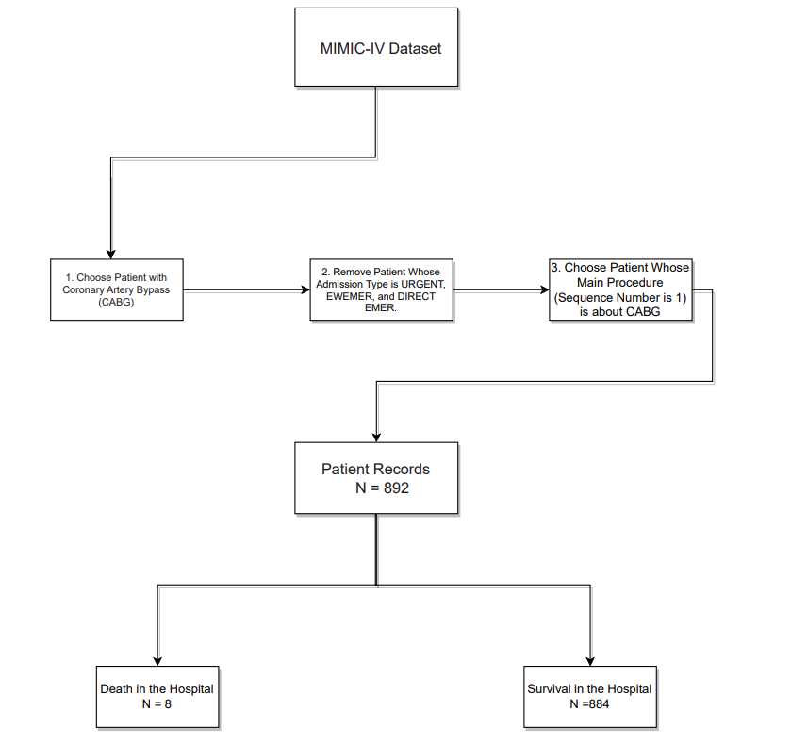
Cohort selection

Slide 8
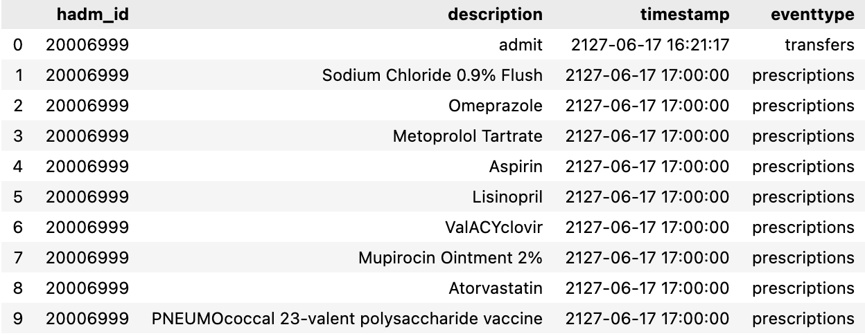
Dataset overview
For each patient:
time-ordered trace containing activities
Admission
Transfer
Lab events
Prescription
Procedure
Example:
Notes:
去字

Slide 9
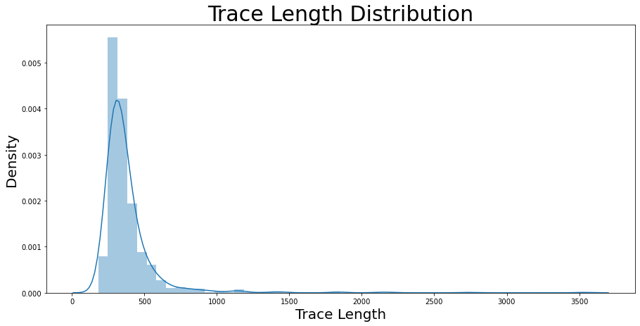
Preliminary analysis

Slide 10
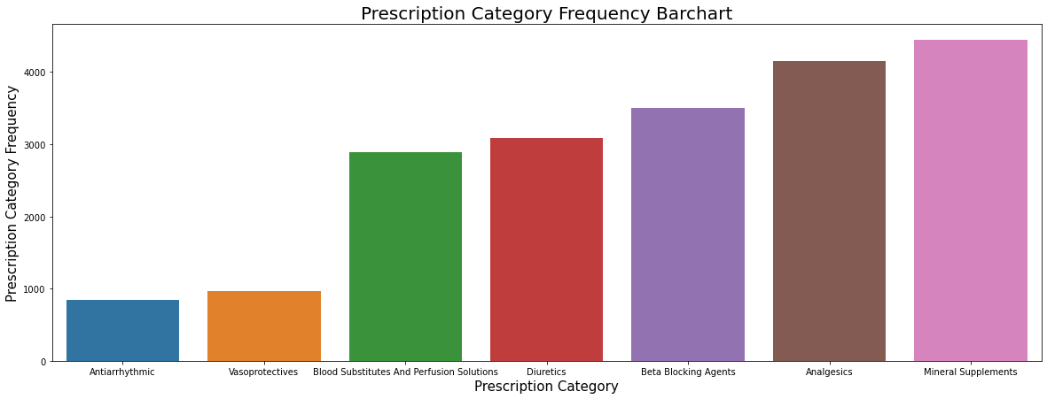
Preliminary analysis
Prescriptions:
668 different drugs

Slide 11
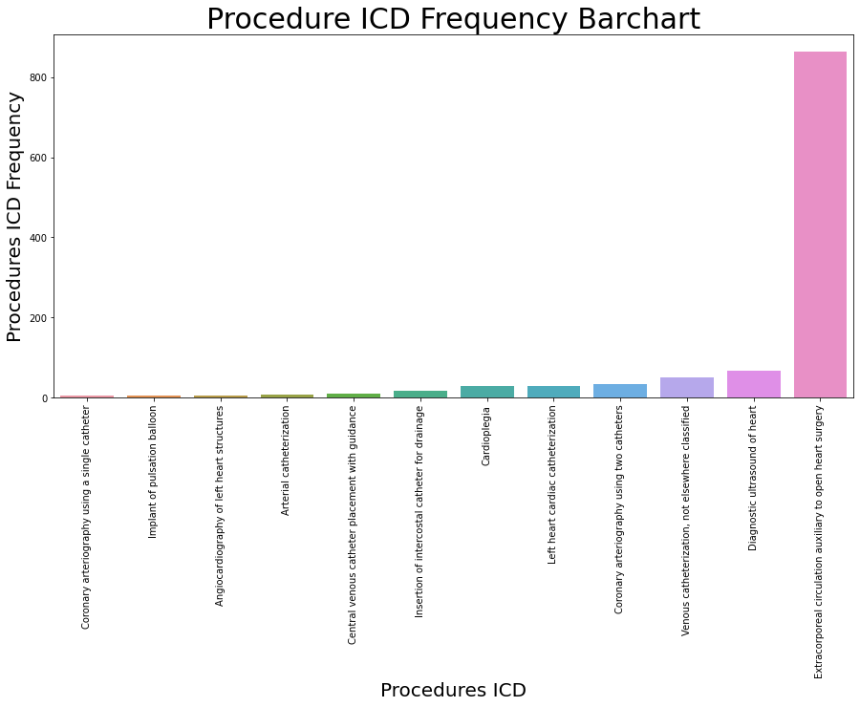
Preliminary analysis
Procedures:
136 different procedures

Slide 12
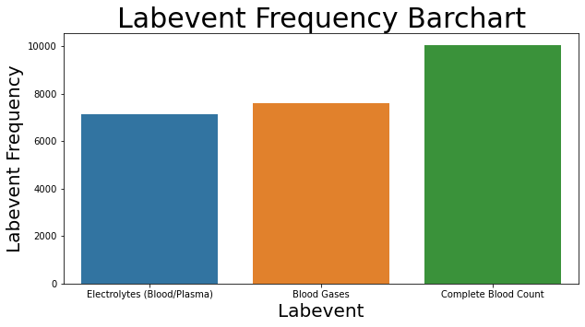
Preliminary analysis
Lab Events:
235 different lab events

Slide 13
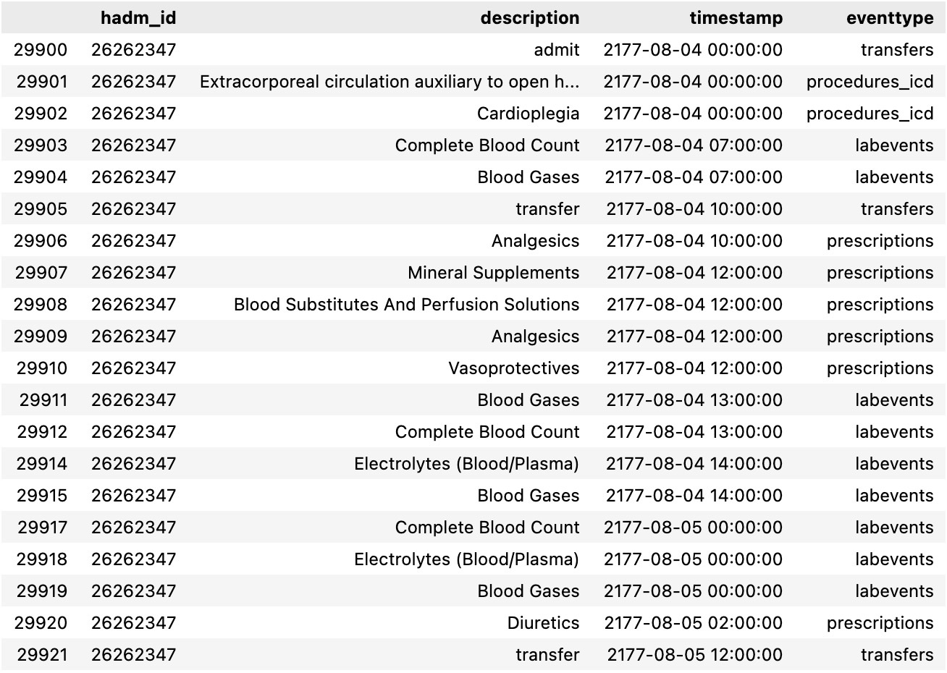
Current result
Raw average trace length~ 400
Filter
Aggregate
Mean:53
Stdv:22
Min:29
Max:334
Current trace length

Slide 14
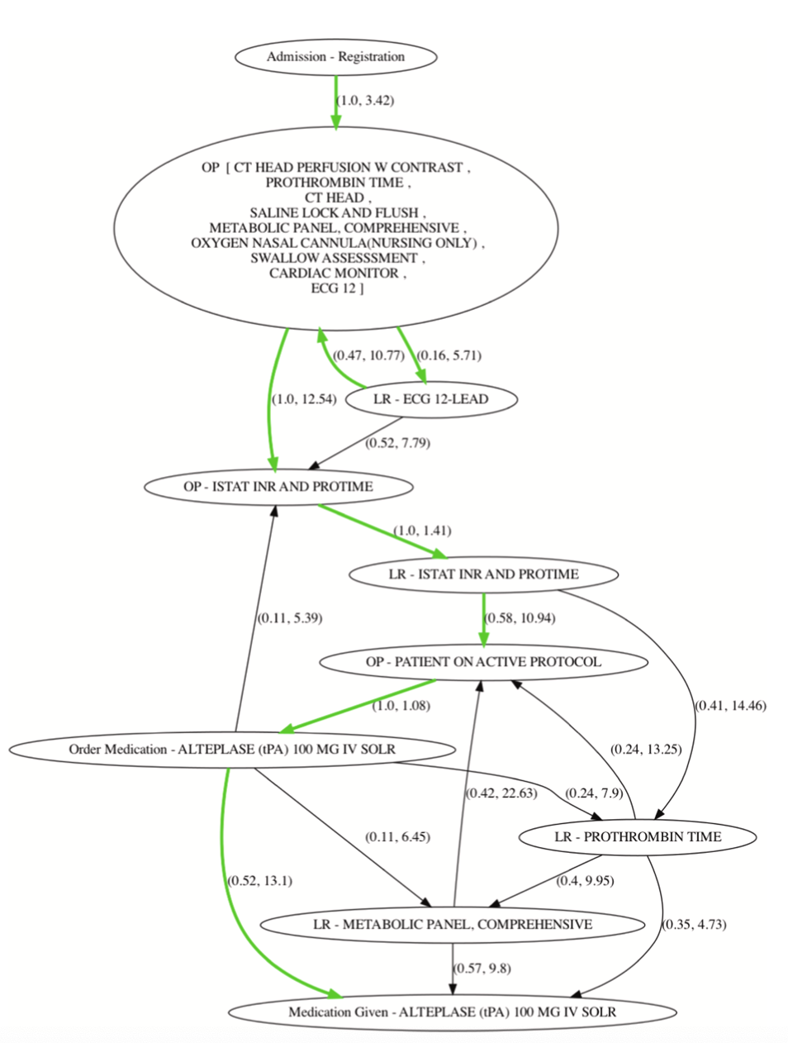
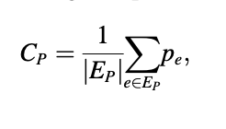
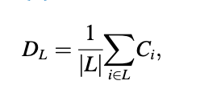
Measure Variability： Method 1
Event log
Process model
node: unique event/aggregated unique event
edge: (probability weight, Lagweight)
Conformance Score:
Patient level
Average

Slide 15
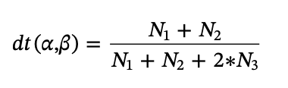
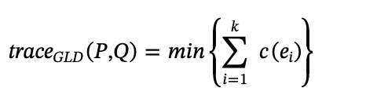
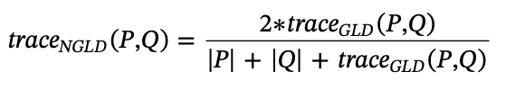
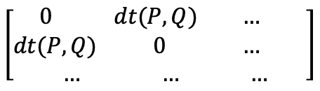
Measure Variability： Method 2
Trace Edit Distance
get
Event log
Trace Distance
dt(P,Q)
Variability Matrix
Interval Distance
$${interval}_{d}\left(i,j\right)=\frac{\left|{len}_{i}−{len}_{j}\right|}{maxlen}$$
P Q
P
Q
Neighbors-graph Distance
$${ngraph}_{d}\left(i,j\right)=\frac{path(i,j,G)}{\max_{k,l∈G}\left\{\left(path\left(k,l,G\right)\right)\right\}}$$

Slide 16

Measure Variability： Method 3
Event log
Apply SPAM (Sequential Pattern Mining)
to generate m unique frequent patterns
Bag-of-Pattern (BoP)
Y
n by m matix
n:number of patient
m: number of pattern
Patient’s
outcome
Generate correlation
List of frequent patterns that has high correlation with patient outcome

Slide 17
Timeline for next semester
Additional research on ways of measuring Variability
Measure variability
Using proposed methods
Adjustment to event categorization
Report writing
/presentation
~1-3 weeks
~2 weeks
~7-10 weeks

Slide 18
Challenges
Lack of domain knowledge in clinical field
Learning new tool (ProM) for getting process model
Developing new ways to measure variability

Slide 19
Thank you!

